Slide 1
Secure Data Hiding in Image Using Steganography
CAPSTONE PROJECT
Presented By:
Student Name : BODIPUDI KRISHNA PRIYA
College Name & Department : BHARATH INSTITUDE OF HIGHER EDUCATION AND RESEARCH&CSE[AIML]

Slide 2
OUTLINE
Problem Statement
Technology used
Wow factor
End users
Result
Conclusion
Git-hub Link
Future scope

Slide 3
Problem Statement
The project "Secure Data Hiding in Image Using Steganography" focuses on embedding confidential data, such as text or files, within digital images without noticeable distortion. By utilizing advanced steganographic techniques, the project ensures the security and integrity of hidden data, making it imperceptible to the human eye while maintaining the original image quality. The goal is to develop a robust system that allows for secure communication and data storage.

Slide 4
Technology used
Programming Language: Python
Libraries: Pillow, OpenCV, NumPy, Cryptography, Stegano
Platform: PyCharm/VS Code, cross-platform (Windows/Linux/macOS)
Version Control: Git (GitHub/GitLab)

Slide 5
Wow factors
The "Secure Data Hiding in Image Using Steganography" project stands out due to its combination of advanced encryption techniques and steganography. Unlike basic steganography methods, this project incorporates a dual-layer security system where the data is first encrypted before being hidden within the image. This ensures that even if the hidden data is discovered, it cannot be accessed without the correct decryption key. The use of encryption adds an extra level of confidentiality, making the system highly secure for sensitive information transfer.
Another unique feature is the project's focus on maintaining the integrity and quality of the original image. It uses sophisticated algorithms that embed data in such a way that the changes are completely imperceptible to the human eye. The system is also highly flexible, allowing users to hide different types of data, from simple text to larger files, without compromising image quality. Additionally, the cross-platform compatibility makes the project accessible to a wider audience, further enhancing its usability and practicality in real-world applications.

Slide 6
End users
The "Secure Data Hiding in Image Using Steganography" project serves a broad range of end users who need secure and discreet data storage and transfer methods. Individuals can use this technology to hide personal information, passwords, or confidential messages in images, ensuring that sensitive content remains hidden from unauthorized access. Businesses and organizations dealing with intellectual property or proprietary data can securely transmit or store files without drawing attention to the hidden information, reducing the risk of data leaks. Cybersecurity professionals benefit from the system by embedding encrypted data into images, offering an extra layer of security for communication over potentially insecure networks. The project is also invaluable for government and military sectors, which require the highest level of confidentiality to transmit sensitive intelligence, making it difficult for adversaries to detect or intercept. Finally, digital forensics experts can use this technology both to securely store data for investigation purposes and to extract hidden information from images during criminal investigations.

Slide 7
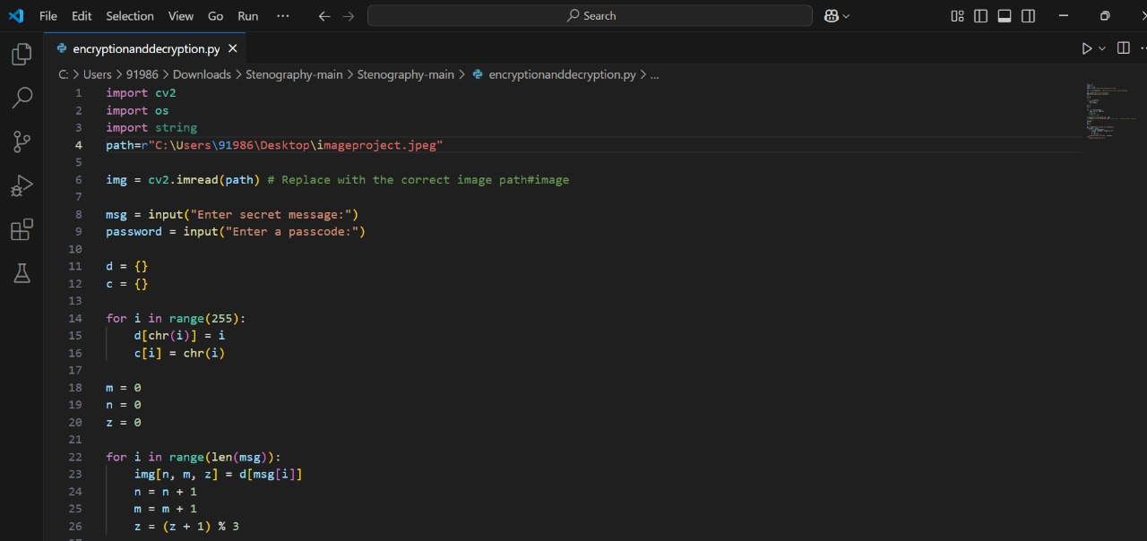
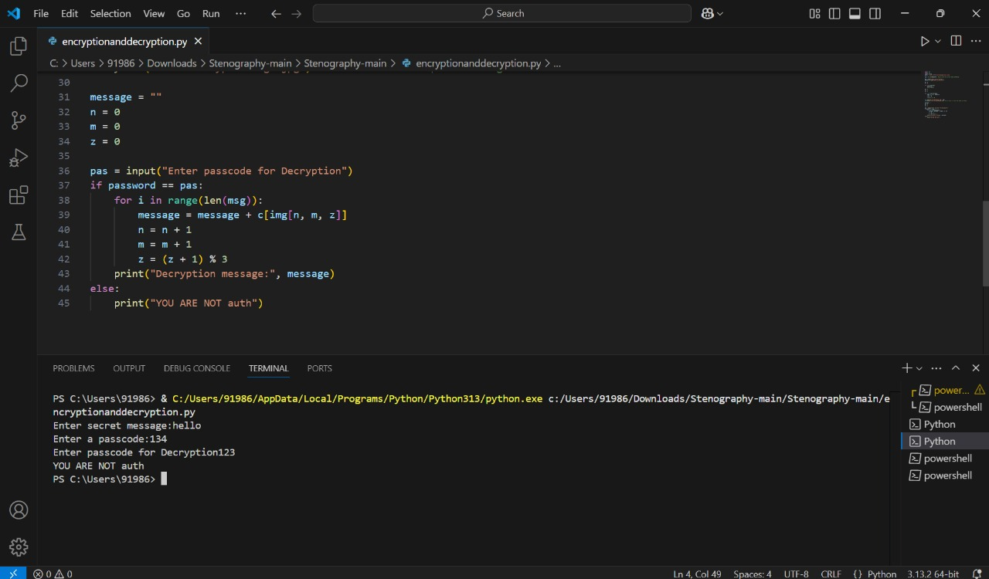
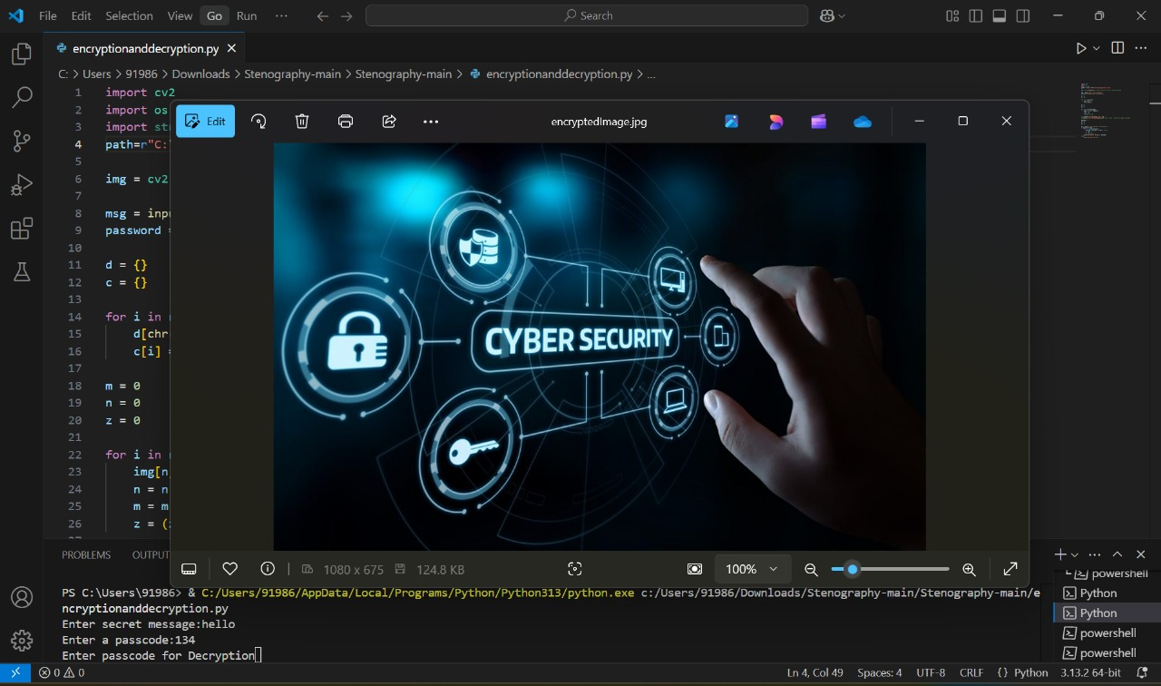
Results

Slide 8
Conclusion
In conclusion, the "Secure Data Hiding in Image Using Steganography" project provides an innovative and reliable solution for secure data storage and communication in the digital age. By combining encryption with steganography, the project ensures that sensitive data remains hidden and secure within digital images, making it undetectable to the human eye while safeguarding it from unauthorized access. The approach preserves the original quality of the image, ensuring that no visible distortion occurs while embedding data, and supports various types of data, from simple text to larger files, offering flexibility for different use cases. Its cross-platform compatibility ensures accessibility across multiple operating systems, making it adaptable for a wide range of users. This project serves a diverse set of end users, including individuals, businesses, cybersecurity professionals, government agencies, and digital forensics experts, addressing their growing need for confidential, secure data transfer and storage. Ultimately, it plays a significant role in enhancing data security, meeting the increasing demands for privacy protection, and providing an effective tool for securing sensitive information in a world where digital threats are ever-present.

Slide 9
GitHub Link
https://github.com/bodipudikrishnapriya/Secure-Data-Hiding-in-Image-Using-Steganographyaicte.git

Slide 10
Future scope(optional)
The future scope of the "Secure Data Hiding in Image Using Steganography" project is promising, with numerous opportunities for enhancement and expansion. One potential direction is the integration of more advanced encryption algorithms to further strengthen security and make hidden data more resistant to attacks. The system could also be extended to support a wider range of file types, including multimedia content like audio and video, broadening its applicability. Additionally, integrating AI or machine learning for automated data extraction could improve efficiency in detecting hidden information. With the growing adoption of cloud technologies, this project could be adapted for cloud storage, offering secure and covert data storage solutions. Future developments could also explore incorporating blockchain for decentralized, tamper-proof data hiding or enabling real-time secure communication systems, enhancing privacy for online messaging. These advancements could make the system a vital tool for secure data transfer and storage across various industries.

Slide 11
THANK YOU

